Slide 1
Principles of Database Systems (CS307) Lecture 12: Trigger; Data Storage Structures
Ran Cheng
Department of Computer Science and Engineering
Southern University of Science and Technology
Most contents are from slides made by Stéphane Faroult, Dr. Yuxin Ma and the authors of Database System Concepts (7th Edition).
Their original slides have been modified to adapt to the schedule of CS307 at SUSTech.

Slide 2
Trigger

Slide 3
Trigger - Actions When Changing Tables
We can attach “actions” to a table
They will be executed automatically whenever the data in the table changes
Purpose of using triggers
Validate data
Checking complex rules
Manage data redundancy
A trigger is a specification that the database should automatically execute a particular function whenever a certain type of operation is performed.
-- Chapter 39, PostgreSQL Documentation
A trigger is a statement that the system executes automatically as a side effect of a modification to the database.
-- Chapter 5.3, Database System Concepts, 7th

Slide 4


Purpose of Using Triggers
Validate data
Some data are badly processed in programs before sending to the database
We need to validate such data before inserting them into the database
“On-the-fly” modification
Change the input directly when the input arrives
永远的神
永远滴神
永远の神
yyds
YYDS
yy的s
“yyds”

Slide 5
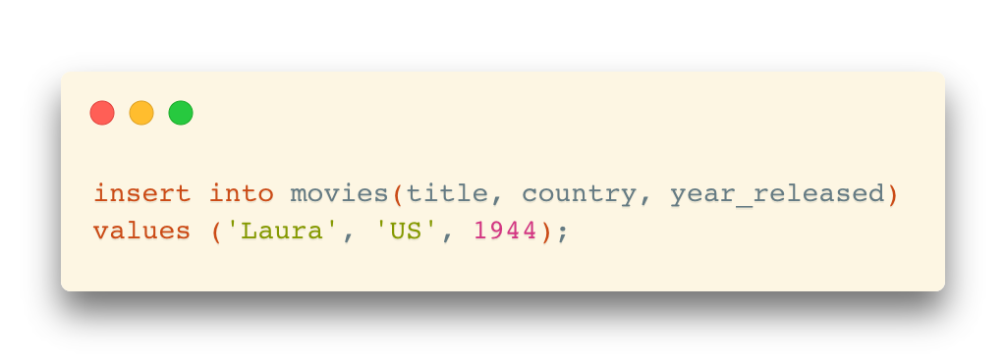
Purpose of Using Triggers
Validate data
Example: insert a row in the movies table
In the JDBC program, an insert request is written like the following:
Although,
Such validation or transformation should be better handled by the application programs
Need to update it to ’us’ before inserting

Slide 6
Purpose of Using Triggers
Check complex rules
Sometimes, the business rules are so complex that it cannot be checked via declarative constraints

Slide 7
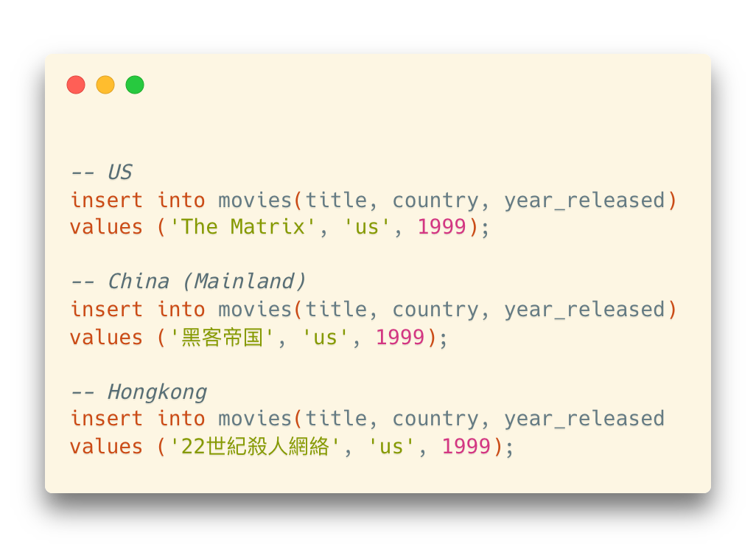
Purpose of Using Triggers
Manage data redundancy
Some redundancy issues may not be avoided by simply adding constraints
For example: We inserted the same movie but in different languages
It satisfies the constraint of uniqueness on (title, country, year_released)
… but they represent the same movie

Slide 8
Trigger Activation
Two key points:
When to fire a trigger?
What (command) fires a trigger?

Slide 9
Trigger Activation
When to fire a trigger?
In general: “During the change of data”
… but we need a detailed discussion
--- Note: “During the change” means select queries won’t fire a trigger.

Slide 10
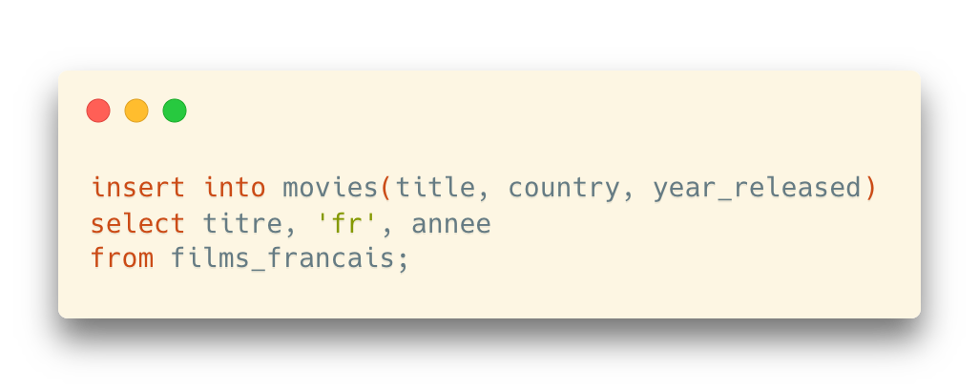
Trigger Activation: When
Example: Insert a set of rows with “insert into select”
One statement, multiple rows

Slide 11
Trigger Activation: When
Example: Insert a set of rows with “insert into select”
One statement, multiple rows
Option 1: Fire a trigger only once for the statement
Before the first row is inserted, or after the last row is inserted
Option 2: Fire a trigger for each row
Before or after the row is inserted

Slide 12






Trigger Activation: When
Different options between DBMS products
Before statement
Before each row
After each row
After statement
Before statement
Before each row
After each row
After statement
Before statement
Before each row
After each row
After statement

Slide 13
Trigger Activation: What
What (command) fires a trigger?
insert
update
delete

Slide 14
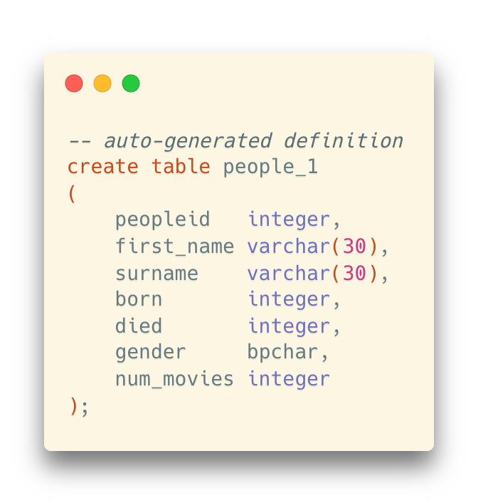
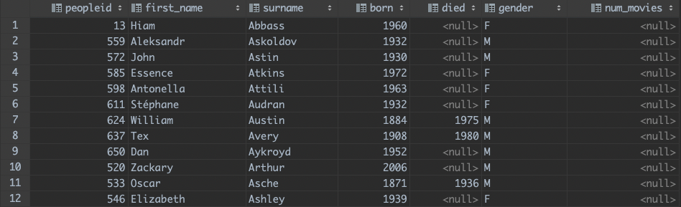
Example of Triggers
A (Toy) Example
For the following people_1 table, count the number of movies when updating a person and save the result in the num_movies column

Slide 15
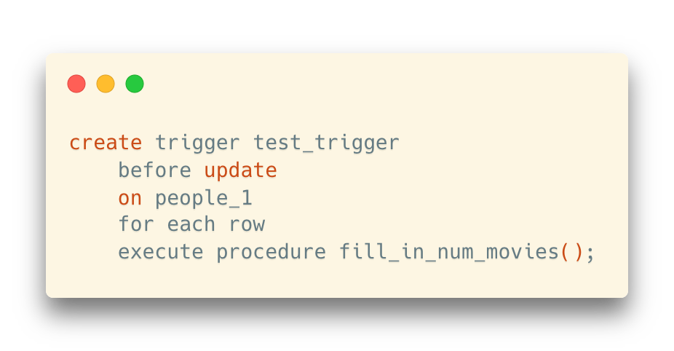
Example of Triggers
Create a trigger

Slide 16
Example of Triggers
Create a trigger
Name of the trigger

Slide 17
Example of Triggers
{ BEFORE | AFTER | INSTEAD OF } { event [ OR ... ] }
Specify when the trigger will be executed
before | after
… and on what operations the trigger will be executed
insert [or update [or delete]]
Create a trigger

Slide 18
Example of Triggers
Create a trigger
The table name
“for each row”
or
“for each statement” (default)

Slide 19
Example of Triggers
Create a trigger
The actual procedure for the trigger

Slide 20
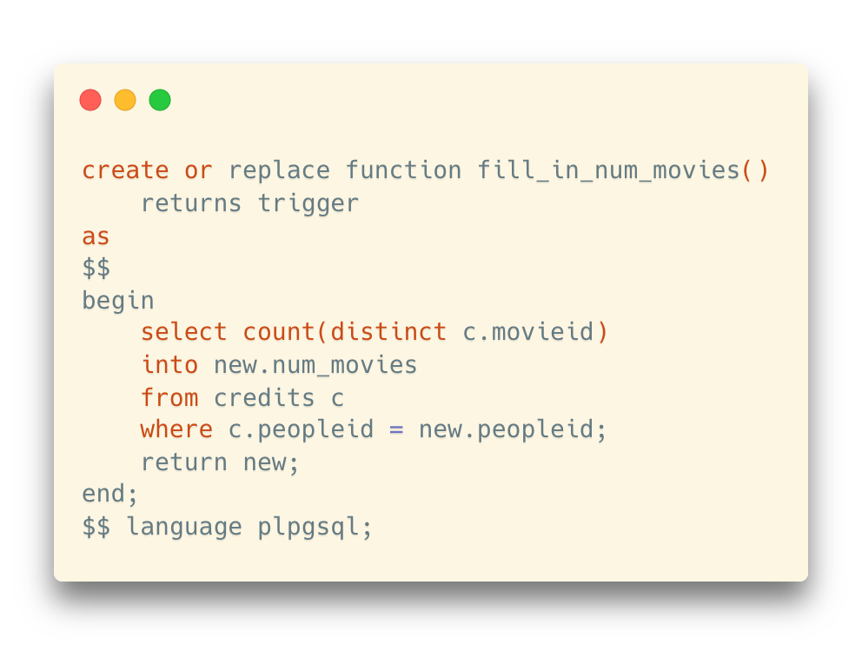
Example of Triggers
Create a trigger
Besides, a corresponding procedure should be created as well

Slide 21
Example of Triggers
Create a trigger
Besides, a corresponding procedure should be created as well
“trigger” is the return type

Slide 22
Example of Triggers
Create a trigger
Besides, a corresponding procedure should be created as well
”new” and “old” are two internal variables that represents the row before and after the changes

Slide 23
Example of Triggers
Create a trigger
Besides, a corresponding procedure should be created as well
Remember to return the result which will be used in the update statement

Slide 24
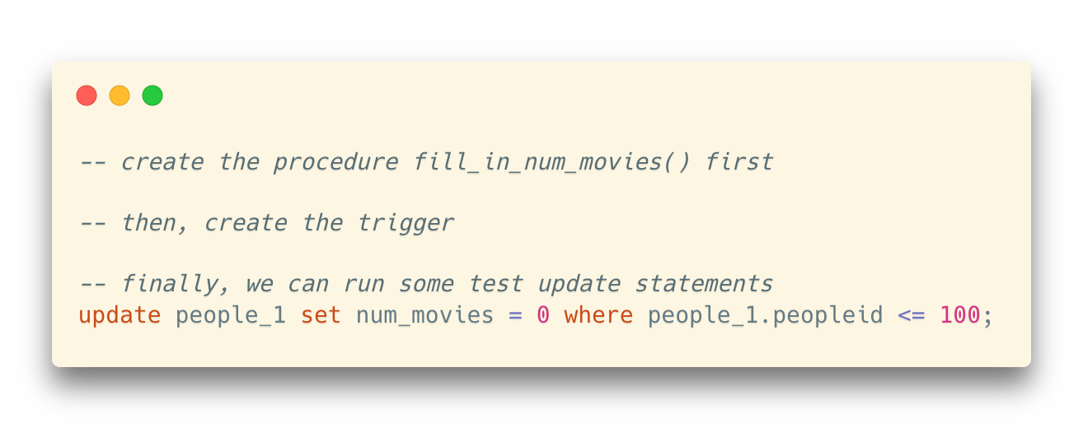
Example of Triggers
Create a trigger
Besides, a corresponding procedure should be created as well
Remember to create the procedure before creating the trigger
Run test updates

Slide 25
Before and After Triggers
Differences between before and after triggers
“Before” and “after” the operation is done (insert, update, delete)
If we want to update the incoming values in an update statement, the “before trigger” should be used since the incoming values have not been written to the table yet

Slide 26
Before and After Triggers
Typical usage scenarios for trigger settings
Modify input on the fly
before insert / update
for each row
Check complex rules
before insert / update / delete
for each row
Manage data redundancy
after insert / update / delete
for each row

Slide 27
Example: Auditing
One good example of managing some data redundancy is keeping an audit trail
It won't do anything for people who steal data
(remember that select cannot fire a trigger – although with the big products you can trace all queries)
… but it may be useful for checking people who modify data that they aren't supposed to modify

Slide 28
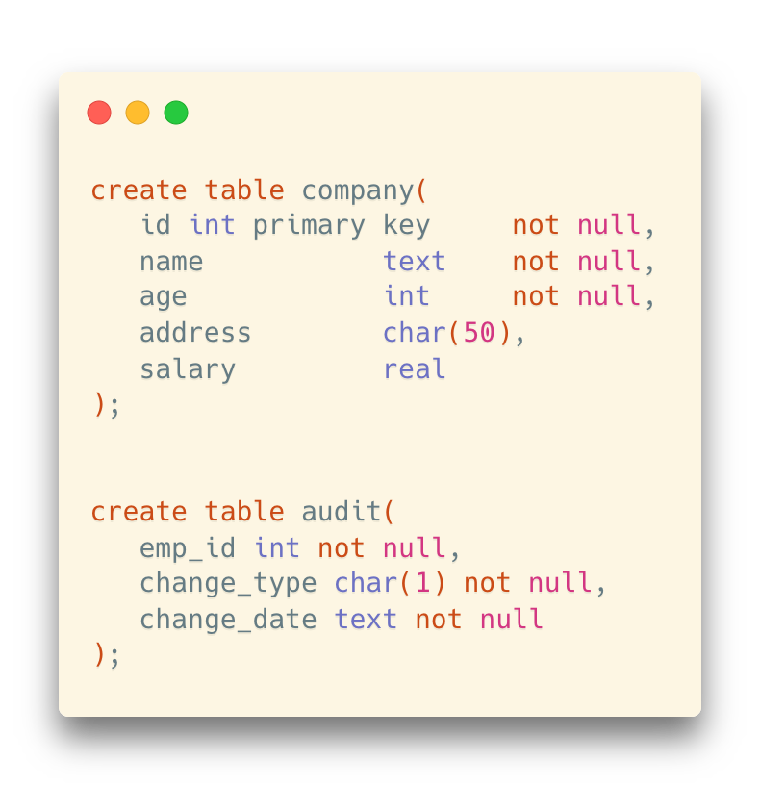
Example: Auditing
Trace the insertions and updates to employees in a company

Slide 29
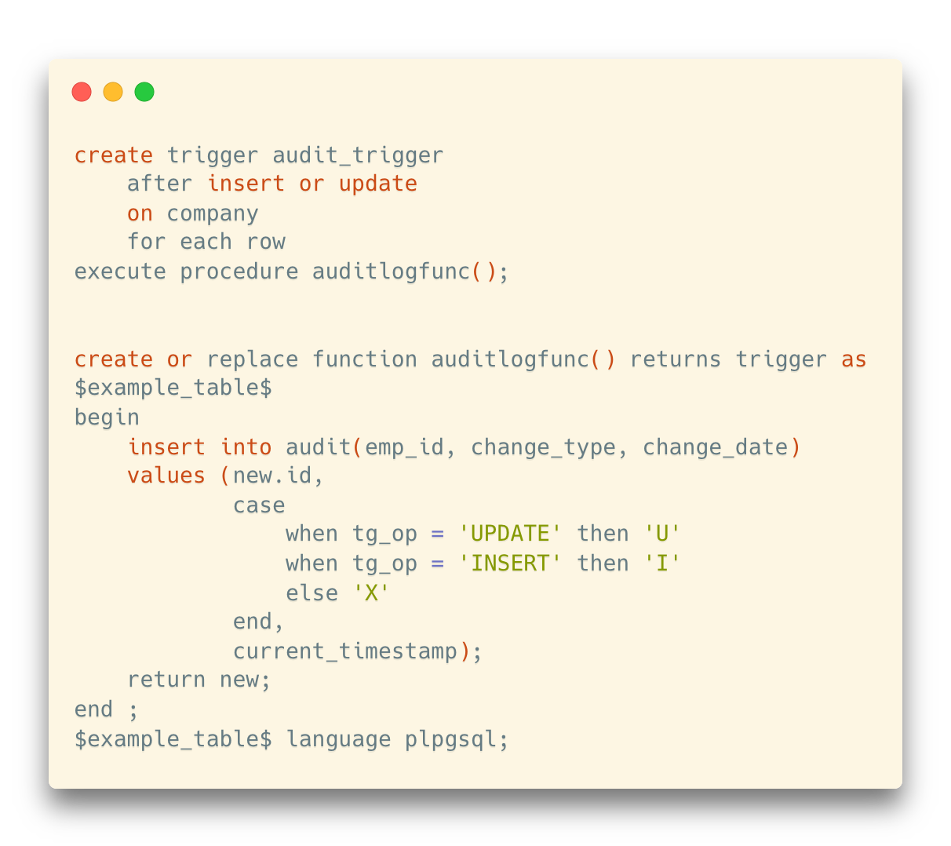
Example: Auditing
Trace the insertions and updates to employees in a company

Slide 30
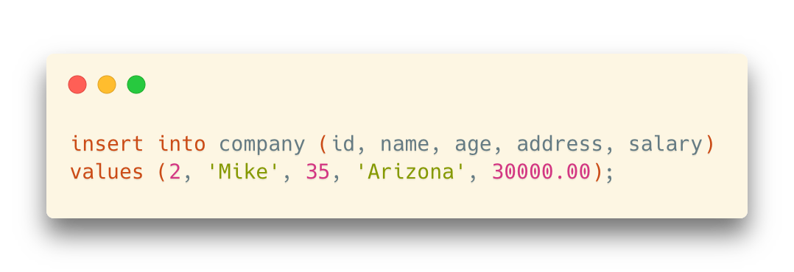
Example: Auditing
Trace the insertions and updates to employees in a company
company
audit

Slide 31
Data Storage Structures

Slide 32
File Organization
The database is stored as a collection of files
Each file is a sequence of records
A record is a sequence of fields.
One approach
Assume record size is fixed
Each file has records of one particular type only
Different files are used for different relations
* This case is easiest to implement; will consider variable length records later
We assume that records are smaller than a disk block

Slide 33
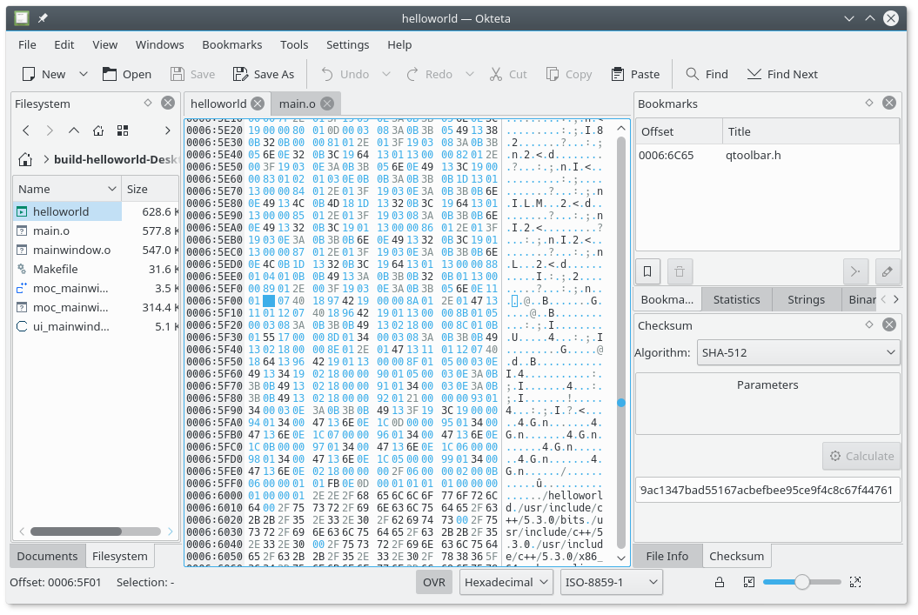
File Organization
Bitmap of a file
https://apps.kde.org/okteta/

Slide 34
File Organization
Goals: Time and Space
Support CURD (Create, Read, Update and Delete) operations as fast as possible
Save storage space as much as possible
Maintain data integrity

Slide 35
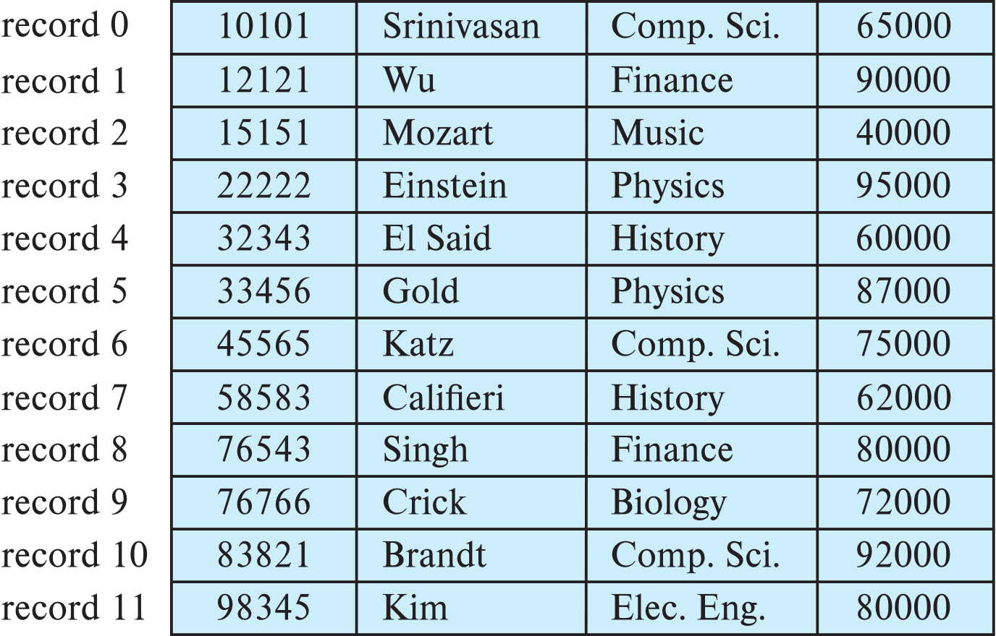
Fixed-Length Records
Simple approach:
Store record i starting from byte n*(i – 1), where n is the size of each record
Record access is simple but records may cross blocks

Slide 36
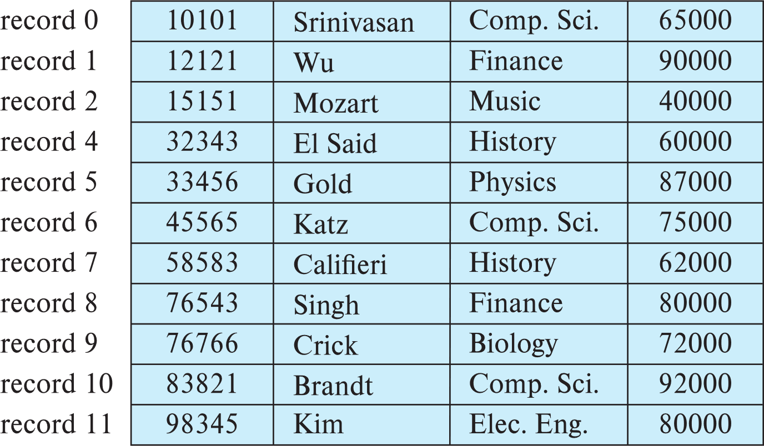
Fixed-Length Records
Deletion of record i
Way #1: move records i + 1, . . ., n to i, . . . , n – 1

Slide 37
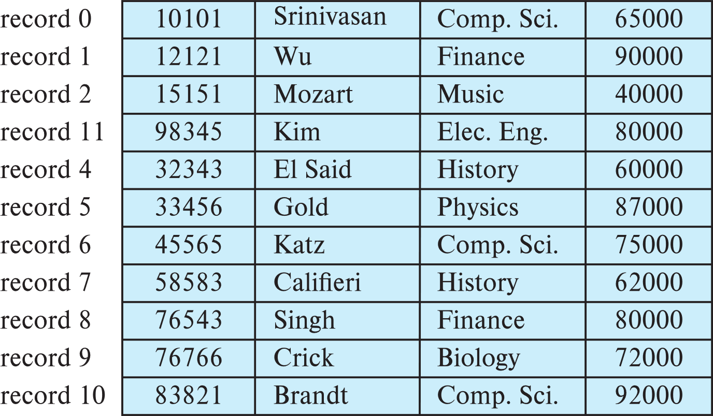
Fixed-Length Records
Deletion of record i
Way #2: move record n to i
Record 3 is removed and replaced by record 11

Slide 38
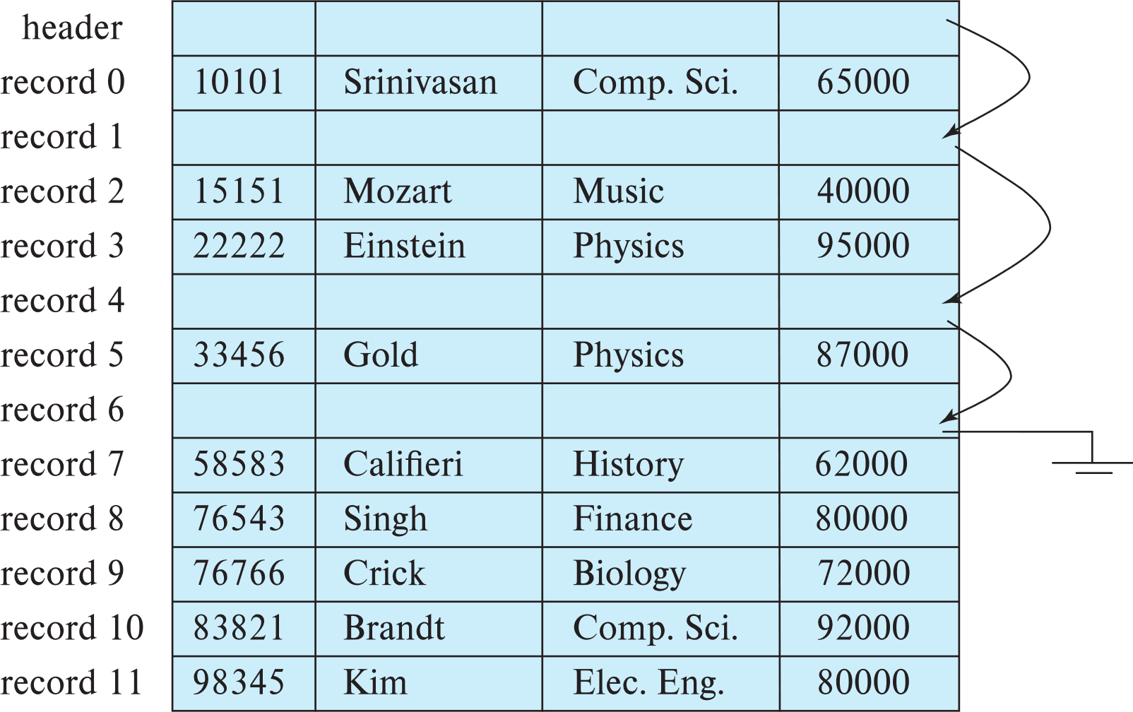
Fixed-Length Records
Deletion of record i
Way #3: Do not move records, but link all free records on a free list

Slide 39
Variable-Length Records
Variable-length records arise in database systems in several ways:
Storage of multiple record types in a file.
Record types that allow variable lengths for one or more fields such as strings (varchar)
Problem with variable-length records
How can we retrieve the data in an easy way without wasting too much space
varchar(1000): do we really need to allocate 1000 bytes for this field, even if most of the actual data items only costs less than 10 bytes?

Slide 40
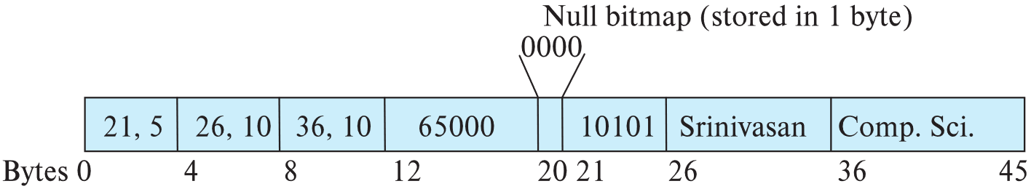
Variable-Length Records
Attributes are stored in order
Variable length attributes represented by fixed size (offset, length), with actual data stored after all fixed length attributes
Null values represented by null-value bitmap
offsets and lengths
The actual data (“10101” in varchar type)

Slide 41
Variable-Length Records
Slotted page header contains:
number of record entries
end of free space in the block
location and size of each record
Records can be moved around within a page to keep them contiguous (连续的) with no empty space between them; entry in the header must be updated.
Pointers should NOT point directly to record — instead they should point to the entry for the record in header.

Slide 42
Storing Large Objects
BLOB和CLOB都是大字段类型，BLOB是按二进制来存储的，而CLOB是可以直接存储文字的。
通常像图片、文件、音乐等信息就用BLOB字段来存储，先将文件转为二进制再存储进去。
而像文章或者是较长的文字，就用CLOB存储，这样对以后的查询更新存储等操作都提供很大的方便。
E.g., blob/clob types
Records must be smaller than pages
Alternatives:
Store as files in file systems
Store as files managed by database
Break into pieces and store in multiple tuples in separate relation
PostgreSQL TOAST
TOAST是“The Oversized-Attribute Storage Technique”（超尺寸属性存储技术）的缩写，主要用于存储一个大字段的值。

Slide 43
Organization of Records in Files
Heap – record can be placed anywhere in the file where there is space
Sequential – store records in sequential order, based on the value of the search key of each record
Multitable clustering file organization
Records of several different relations can be stored in the same file
Motivation: store related records on the same block to minimize I/O
B+-tree file organization
Ordered storage even with inserts/deletes
Hashing – a hash function computed on search key; the result specifies in which block of the file the record should be placed

Slide 44
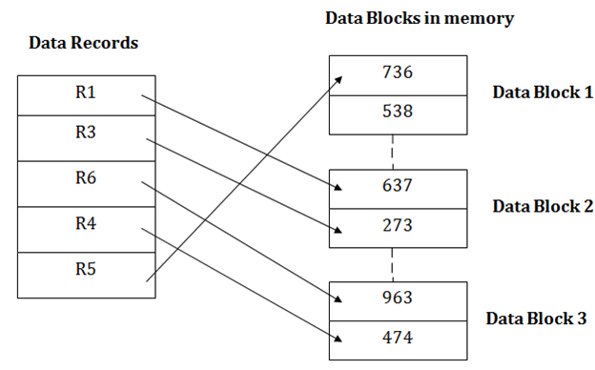
Heap File Organization
Records can be placed anywhere in the file where there is free space
Records usually do not move once allocated
Important to be able to efficiently find free space within file
Free-space map
Array with 1 entry per block. Each entry is a few bits to a byte, and records fraction of block that is free
Free space map written to disk periodically, OK to have wrong (old) values for some entries (will be detected and fixed)

Slide 45
Sequential File Organization
Suitable for applications that require sequential processing of the entire file
The records in the file are ordered by a search-key

Slide 46
Sequential File Organization
Deletion – Use pointer chains
Insertion – Locate the position where the record is to be inserted
if there is free space insert there
if no free space, insert the record in an overflow block
In either case, pointer chain must be updated
Need to reorganize the file from time to time to restore sequential order

Slide 47
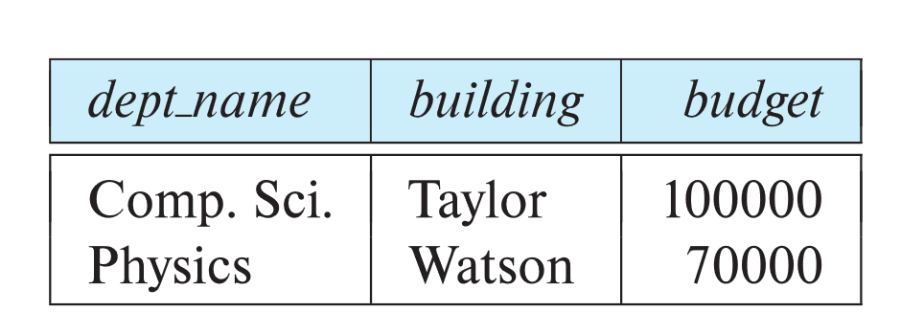
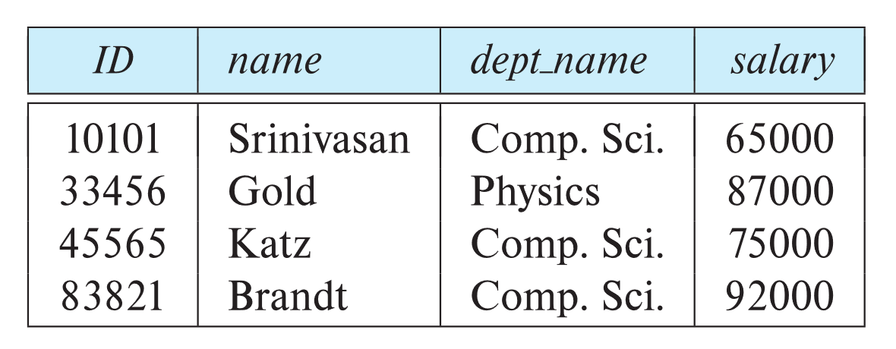
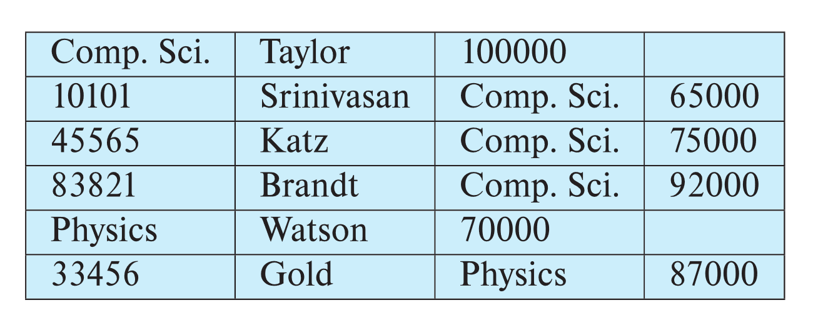
Multitable Clustering File Organization
Store several relations in one file using a multitable clustering file organization
Good for queries involving:
department ⨝ instructor
or, one single department and its instructors
Bad for queries involving only department
Results in variable size records
Can add pointer chains to link records of a particular relation
department
instructor
Multitable clustering
of department and
instructor

Slide 48
Partitioning
Table partitioning: Records in a relation can be partitioned into smaller relations that are stored separately
E.g., transaction relation may be partitioned into transaction_2018, transaction_2019, etc.
Queries written on transaction must access records in all partitions
Unless query has a selection such as year=2019, in which case only one partition in needed
Partitioning
Reduces costs of some operations such as free space management
Allows different partitions to be stored on different storage devices
E.g., transaction partition for current year on SSD, for older years on magnetic disk

